Slide 1
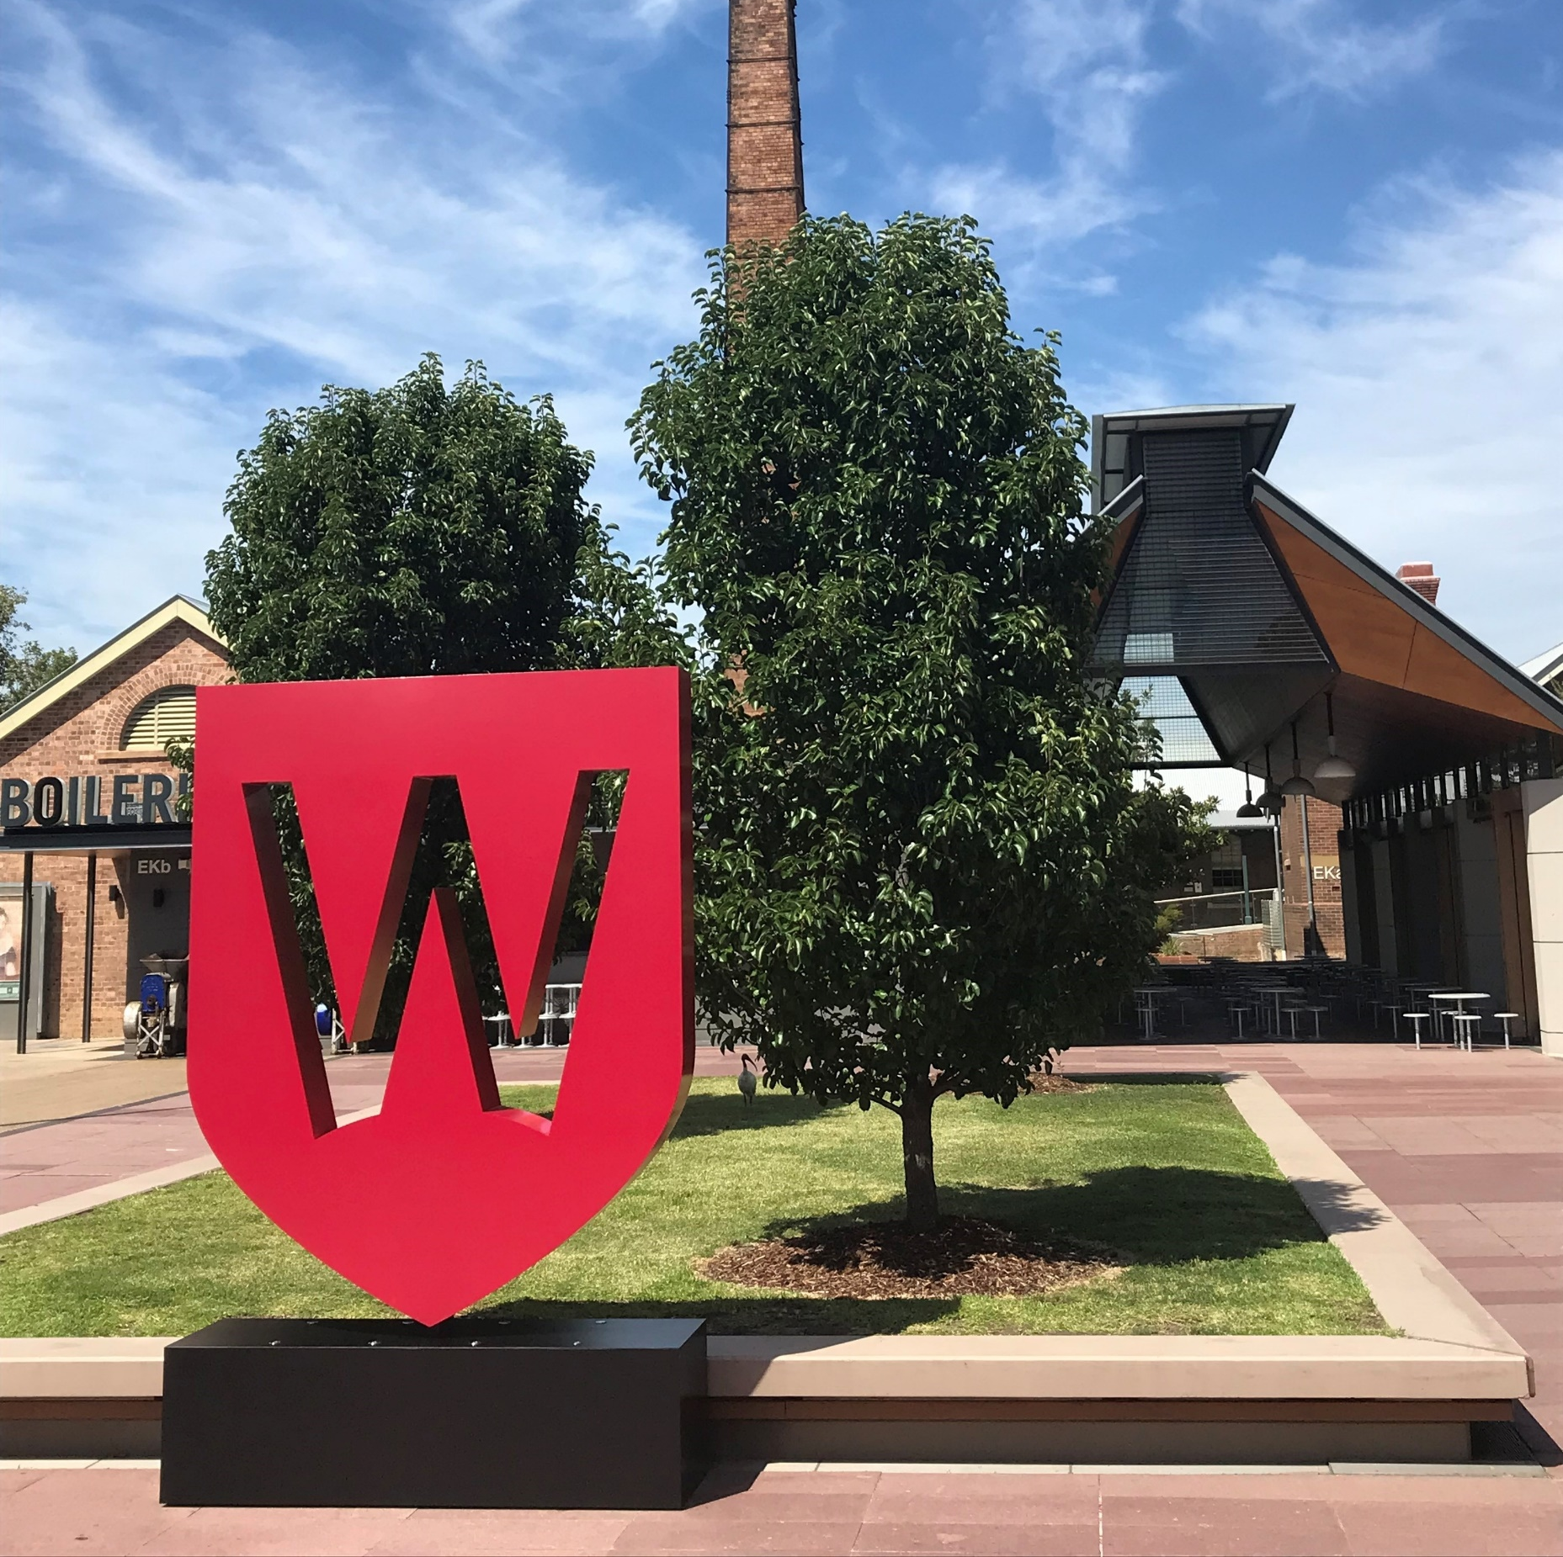

NTEU Western Sydney Branch
Academic Workloads:
What is Going On?
Presentation for Members’ Meeting, 17 February, 2026

Slide 2
The 40-40-20 Imperative
Shortly after his arrival the VC indicated his intention to move WSU to a 40-40-20 workloads system, analogous to that used at his previous university, UNSW.
So far as is known, he never considered in detail how this would work in practice (40% = what?), or how much it would cost.
He also suggested this system would involve ‘education-focussed roles’ as at UNSW. But at UNSW these roles are a different category of academic employment, and effectively have 80% teaching.
Lastly, a strong suggestion that fitness for 40% research would be measured through the performance review system, raising the spectre of mass unsat performance worries, if existing research metrics were followed.

Slide 3
The EA and the University Policy
Since 2012 academic workloads at Western have been managed in a hierarchy of industrial and policy instruments: the workloads clauses in the Academic EA, the University Workplan Committee and Policy, and School committees and policies.
The VC initially attempted to create his new system without reference to these procedures and safeguards. Management declined to discuss workloads in bargaining (other than to press education-focussed roles).
And in late 2025 the Chair of UWPC attempted to unilaterally delete much of the University Policy, at the VC’s request. In response, the NTEU notified an industrial dispute.

Slide 4
The Compromise Settlement
NTEU met with the VC, the UWPC Chair and Management lead bargainer before Xmas to hammer out a compromise process and settlement.
The new EA would reference 40-40-20 as the ‘normal’ profile, but allow other research and teaching positions between 20% and 60% (and vice versa). There would be an extended transition process for those opting for 40-40-20.
There would be a detailed explanation of the real-world correlates of 40% teaching. And the new clause in the EA and the new Policy would be agreed in tandem.

Slide 5
The Timeline?
The parties failed to conclude bargaining by shutdown in December 2025, and there was still no agreement on academic workloads teaching allocations or performance measures.
Bargaining was concluded at a marathon session on January 20, with in principle agreement on a new academic workloads clause.
UWPC met the following week, and came close to agreement on a new University Policy, which was agreed in principle a fortnight ago. However, the EAs are still caught up in final drafting and checks. And the new Policy has not been circulated by Management to this point.
Hence, Deans, School Committees and supervisors have been left entirely in the dark in preparing workloads for 2026.

Slide 6
Essential Elements of the New System
School committees will be required to peg teaching % allocations against real-world correlates: delivery, preparation, the actual time required for marking, travel, subject coordination etc. There will be indicative teaching profiles with real-world examples. These figures will ‘anchor’ the 40-40-20 system.
Staff and supervisors will agree on appropriate research and teaching allocations (40-40-20, 20-60-20, 60-20-20 or other spaces in-between) based on performance and aspirations
The EA (23.25) and Policy will both stipulate that ‘academic performance in research and related activities will be assessed relative to the percentage research allocation agreed between Employee and supervisor in each annual IWA.’
Since admin and governance is proposed to be a flat 20%, it is still unclear how staff will be encouraged to take on additional admin/governance roles

Slide 7
Our Advice to Members
It was important to the VC that he announce a new system would come into effect from January 1 this year. In practice, however, there has been no clear guidance to Schools, Deans or staff, and different Schools have improvised ways to manage workloads for Autumn and first-half semesters.
The University Policy has been agreed (but not circulated), but the new EA will not become operative until March-April. The teaching real-world correlates will need to be worked-through in School committees throughout the year
Under the new Policy, you are entitled to ‘bid’ for 40-40-20, if you believe your research output will be adequate to meet these expectations over the next triennium.
But in practice most staff will probably be operating under their 2025 School policies, at least for Autumn. It is possible to re-negotiate your IWA for Spring.
As previously, you are entitled to lodge an individual dispute if you cannot agree to your proposed workload allocations.
There will probably be pressure in some Schools for staff to take on above-load teaching in Autumn, given the loss of staffing in the VR debacle. The University needs to hire replacement staff as a matter of urgency, if these teaching holes are to be covered. A compromise might be higher loads for some staff in Autumn and lower in Spring (once new hires have been onboarded).

